Slide 2
Students will be able to:

Slide 3
Reflexes
Reflexes occur as a response to a sudden change in the environment. All reflexes share four properties:
A stimulus is required for a reflex to occur.
All reflexes are involuntary.
Responses are rapid.
Responses are the same for the same stimulus.
Notes:
Teacher Cue – refer to the vocabulary box as you read through and “unpack” the definition provided. Use hand gestures to emphasise the ”2 or more”, “mixed” and “separated” parts of the definition.
Have students complete CFU 1 as a pair-share, then record these definitions & examples as notes (with diagrams) if desired.
CFU 2 – pair-share, then whiteboards for answers – call on non-volunteers.

Slide 4
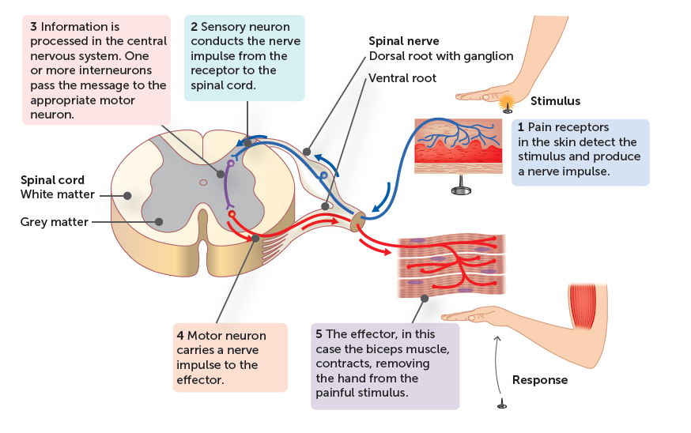
Reflexes
While some reflexes are integrated by the brain, most go directly to the spinal cord-these are called spinal reflexes. The sensory information from the receptor is relayed either to an interneuron and then to a motor neuron, or it passes directly to a motor neuron somewhere along the spinal cord.
While the brain is not involved in the reflex itself, it does become aware of the change in the environment after the reflex has begun.
Notes:
CFU – read through the slide, have students look closely at the diagram, then allow think time, before asking them to explain it to their partner using the key terms pure substance and mixture. Call on non-volunteers and provide feedback, encouraging detailed responses in full sentence form.

Slide 5
Reflexes
The reflex occurs through the steps along a pathway called a reflex arc (or a spinal reflex arc) and these steps are as follows:
1. Receptor: a receptor (which is closely associated with a sensory neuron) detects a change in the environment and the sensory neuron initiates a nervous impulse.
2. Relay to CNS: the impulse is carried towards the spinal cord.
3. Integration: at least one synapse is involved as the impulse reaches the spinal cord and is passed an interneuron (which then relays the impulse to a motor neuron) or directly to the motor to either neuron.
4. Relay effector: the motor neuron carries the impulse to an effector.
5. Response: the effector carries out the appropriate response.

Slide 6
Reflexes
It is interesting to note that while many reflexes are acquired through development, many are innate and determined genetically from birth.

